Slide 1
Gender Diversity Presentation by Sassy Panda (Suhesna Basu)

Slide 2
The business case for inclusion and diversity is stronger than ever. Taking a closer look at diversity winners reveals what can drive real progress.
—Excerpt from Mckinsey Report

Slide 3
INTRODUCTION
Our mission
To identify all forms that are required to be filled that can have gender diversity related information and figure out what analysis that can be done to determine gender differences.
Forthcoming McKinsey report, about Latin America, highlights the strong correlation between gender diversity and positive behavior directly related to better organizational health—which, in turn, is associated with better business performance.
Similarly, their previous research found that women tend to demonstrate, more often than men, five of the nine types of leadership behavior that improve organizational performance.
Inclusion and diversity are at risk in the crisis-but are critical for business recovery, resilience, and reimagination

Slide 4
Objectives
Summary of what I wanted to achieve through this analysis.
“Design a logic for gender diversity data scraping”
The project tries to scrape through the forms and saves info of gender diversity for analysis and further processing.
“Automate forms extraction”
The project automatically extracts the relevant documents form the weblinks for analysis.
“Analyze the data for trends”
The project aims to use the data extracted for further gender diversity analysis.

Slide 5
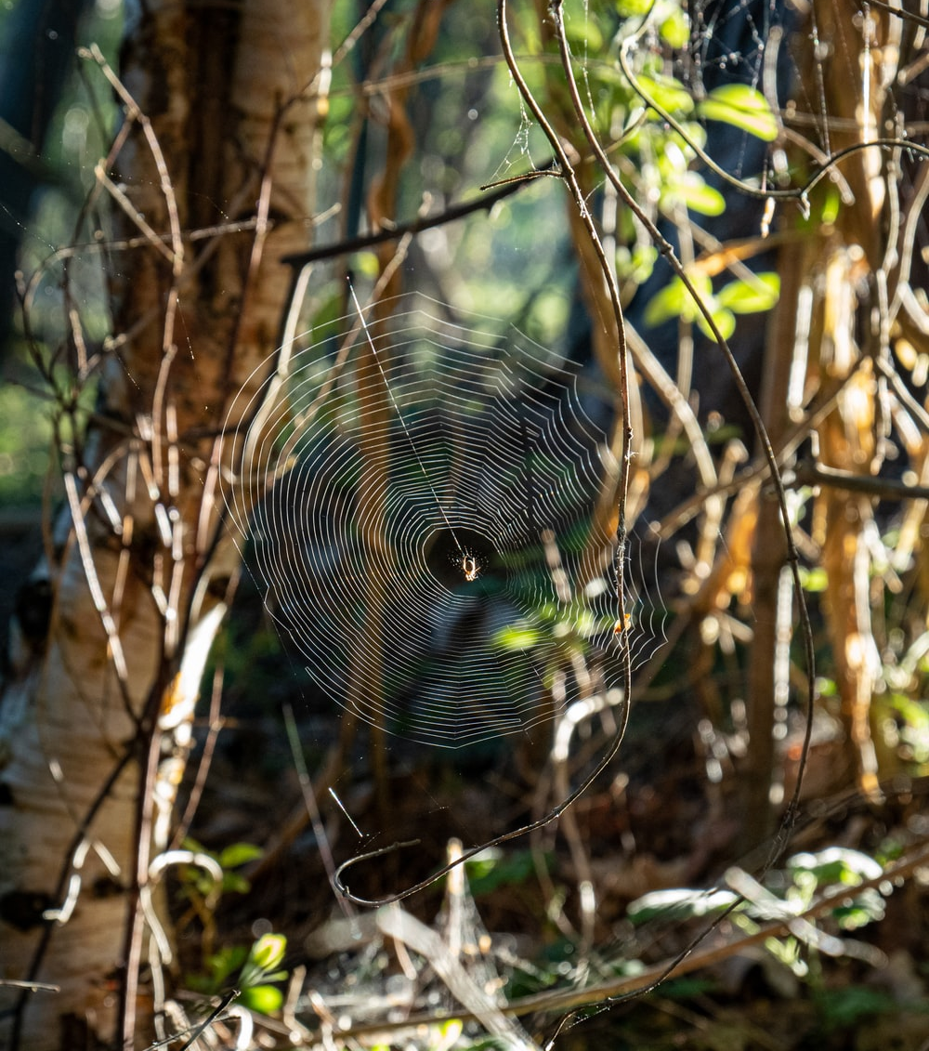
Web Scraping
Web scraping is the process of collecting structured web data in an automated fashion. It's also called web data extraction. Some of the main use cases of web scraping include price monitoring, price intelligence, news monitoring, lead generation and market research among many others.

Slide 6
Primary
Modules
Requests : Requests is a simple, yet elegant HTTP library. Requests allows you to send HTTP/1.1 requests extremely easily. There’s no need to manually add query strings to your URLs, or to form-encode your POST data.
BeautifulSoup : Beautiful Soup is a Python library for pulling data out of HTML and XML files. It works with your favorite parser to provide idiomatic ways of navigating, searching, and modifying the parse tree.
Regular Expressions : A regular expression (or RE) specifies a set of strings that matches it; the functions in this module let you check if a particular string matches a given regular expression (or if a given regular expression matches a particular string, which comes down to the same thing).
Matplotlib: Matplotlib is a comprehensive library for creating static, animated, and interactive visualizations in Python.

Slide 7
Project analysis slide 4
Process flow
Page URL
Response object
Beautiful Soup module
requests module
Response_object.text
Using .select property
To extract relevant
HTML tag
Data for analysis
PDF Text
Requests module
Download Link
Function containing regex query
requests module
Appended to homepage URL

Slide 8
Project analysis slide 5
Code snippet for Streaming Pdfs
#passing off the page url of the forms page
r = requests.get('https://www.sec.gov/forms’)
#passing off the requests.Response.text to BeautifulSoup
soup = bs(r.text,features="lxml")
#Selecting relevant HTML tag for link extraction
download_link = soup.select('td[class="display-title-content views-field views-field-field-display-title"]’)
‘ ‘ ‘List of lists for storing the extracted document names and the documents mentioned this should be converted to a DataFrame later for trend analysis using Matplotlib ’ ‘ ‘
data = []
#for each link in the page complete the url and extract gender details mentioned
for each_link in download_link:
print(each_link.a.get_text())
pdf_link = "https://www.sec.gov" + each_link.a['href’]
#Calling requests module again after this step for streaming the pdf.

Slide 9
The Pdfs texts obtained in the previous step is skimmed using regex for gender diversity info and the relevant data is converted and stored in a DataFrame for analysis.
Analysis of output
Note: The code analysis that follows was run on a small pdf set limited to 5 pdfs for the purpose of simplicity.

Slide 10
Project analysis slide 5
Code snippet for Converting Code outputs to DF and Plotting
#Converting the data lists of lists to a DataFrame and naming the columns as Names and Gender
df = pd.DataFrame(data, columns=['Names', 'Gender'])
print(df)
#Converting the data lists of lists to a DataFrame and naming the columns as Names and Gender
count_values = df['Gender'].value_counts()
print(count_values)
print(type(count_values))
df.Gender.value_counts().plot(kind='bar’)
plt.show()

Slide 11
Project analysis slide 5
Code snippet for Converting Code outputs to DF and Plotting
Output:
In [16]: runfile('D:/Python_scraping_script/Sassy_Panda_Forms_Recognition.py', wdir='D:/Python_scraping_script')
Application for registration or exemption from registration as a national securities exchange (PDF)
[Done]
Regulation A Offering Statement (PDF)
[Done]
Notification under Regulation E (PDF)
[Done]
Annual Reports and Special Financial Reports (PDF)
[Done]
Form and amendments for notice of registration as a national securities exchange for the sole purpose of trading security futures products (PDF)
[['Regulation A Offering Statement (PDF)', 'Male'], ['Notification under Regulation E (PDF)', 'Male’]]
Names Gender
0 Regulation A Offering Statement (PDF) Male
1 Notification under Regulation E (PDF) Male
Male 2
Name: Gender, dtype: int64
<class 'pandas.core.series.Series'>
Data scraped and the inference output

Slide 12
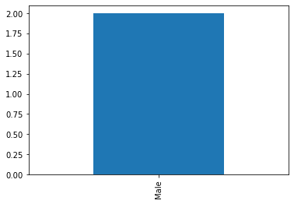
Project analysis slide 5
Project Analysis
SUMMARY OF FIRST 5 PDFS
ADDITIONAL INFO THAT CAN BE EXTRACTED
There are 2 Pdfs with Male diversity info and none with female diversity info
The data obtained can be further sorted into each classes as shown in the next slide and each class of document can be analyzed for gender diversity info.

Slide 13
Project analysis slide 2
Possible categorical separations of forms for Gender Diversity Analysis
Applications
Reports
Notifications
Forms
Page
Statements
Appointments
Complaints & Requests
Information
Certification

Slide 14
Thank You
By Suhesna Basu
Team : Sassy Panda

